Slide 1
Bariatric Surgery: Beyond the First Year Webinar
Notes:
I am your Host.

Slide 2
Goals of presentation
Discuss weight loss expectations after bariatric surgery
Provide tips for staying on track with healthy habits
Review possible long-term complications
Next steps
Discuss Weight regain

Slide 3
What does weight loss look like after Bariatric Surgery?
Many people do not reach “normal” BMI”
Gaining 10-20 pounds from your lowest weight during the first few years after surgery is considered normal
Focus should shift from weight loss to weight maintenance after 1st year
Total weight loss can vary by procedure, individual genetic response, activity levels & food choices
Weight loss typically stops between 12-24 months after surgery depending on procedure.
This is normal and expected
BMI may drop 14-20 points after surgery
Total weight loss expectation: 20-40% of your initial weight depending on procedure type

Slide 4
Defining success after Bariatric Surgery
Bariatric surgery is a tool to help you live at, and maintain your “best” weight which may differ from your expected “ideal” weight
“A patient's best weight is… the healthiest lifestyle a patient can realistically enjoy, not the healthiest lifestyle a patient can tolerate… There comes a point when a person cannot eat less or exercise more and still like their life. The weight they attain while still liking their life is thus their “best” weight…”
Dr. Yoni Freedhoff and Dr. Arya Sharma

Slide 5
Defining success after bariatric surgery
Think about what else surgery has helped you accomplished in addition to weight loss
Resolution or improvement of health issues such as diabetes or high blood pressure
Reduction in pain
Better relationships
Healthier lifestyle
Improved mobility

Slide 6
Tips for staying on track with healthy habits
Follow a consistent meal routine
Eat healthy, well balanced meals and snacks (remember the plate model)
Be mindful of your portion sizes
Plan for success
Practice mindful eating
Choose healthy beverages
Read food labels to ensure your choices are low sugar and low fat
Stay active
Use self monitoring tools
Avoid mindless and emotional eating habits
Practice self care
Tips for staying on track beyond the first year:
Notes:
Rules of the tool help you to achieve optimal nutrition status & weight loss.

Slide 7
Stay on track: Follow a consistent meal routine
Eat 3 meals + 1-2 snacks daily
Space your meals 4 to 5 hours apart
Eat your snack 2 to 2.5 hour after your meal
Adjust your meal routine according to your sleep and work schedule
Eat your first meal of the day within 90 minutes of waking
Avoid skipping meals!
Practice mindful eating (eat slowly, chew well, separate fluids and solids)

Slide 8
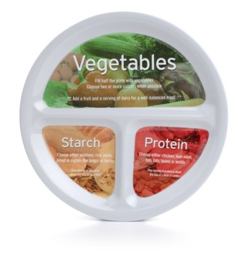
Stay on track: Eat well balanced meals
Protein | Grains/Starch /Fruit | Vegetables | Healthy Fats
Poultry Extra Lean/ Lean meat Fish Eggs Dairy - 0-1% Cottage Cheese - 0-1% Greek yogurt - Cheese (less than 18% Milk Fat) Beans, lentils, legumes Tofu, Tempeh Textured vegetable protein Protein shake or bars or powder (use between meals as needed) | Whole grain bread * Whole grain rice * Whole grain pasta * Quinoa Couscous Oats Barley Starchy vegetables: - Corn - Potato - Sweet potato - Yam - Squash -pumpkin - Turnip - Green Peas -Green plantain Fruits (frozen / fresh / canned in water) * May not be well tolerated after bariatric surgery | Artichoke Asparagus Beets Broccoli Broccolini Brussel Sprouts Cauliflower Cabbage Carrot Celery Cucumber Eggplant Green Leafy vegetables Jicama Mushrooms Okra Onions Peppers Radishes Rapini Sprouts Tomato Zucchini | Avocado Butter Store bought hummus Nuts Seeds Nut and seed butters Olive, Avocado, Canola Oil Low fat salad dressing Trans fat free margarine
Healthy fat

Slide 9
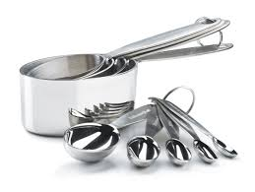
Stay on track: Portion control
Breakfast
Lunch
Dinner
AM snack
PM snack
1-2oz of protein
2-3 oz of protein
3 oz of protein
1 oz of protein
1 fruit
1 oz of protein
1 fruit
1 serving of
Fruit or grain
¼ cup
starch
¼ to ½ cup
Non-starchy vegetables
¼ cup
starch
¼ to ½ cup
Non-starchy vegetables
Healthy fat
Healthy fat
Note: Limit portion of fat to 1 serving per meal
Weigh and measure your portions

Slide 10
Stay on track: Plan for success
Set aside time to plan
Prep meals ahead
Keep nutritious food available
Pack
Try one new recipe each week
Grocery shop
Limit dining out to no more than once per week
Refer to https://youtu.be/4Pt8CWlRlD8
Notes:
Clean out your cupboards, fridge/freezer, and pantries of any higher calorie foods such as chips, ice cream, soda pop, chocolate etc. Do not keep these foods in your house, desk drawer, car etc. Keep your home filled with nutritious foods and snacks. Plan ahead or grocery shop as often as possible to keep a fresh supply of nutritious food.

Slide 11
Stay on track: Choose healthy beverages
Don’t drink your calories!
Aim for 6-8 cups non-carbonated, caffeine and calorie free fluid daily
Calories in beverages do not provide the same fullness cues as solid foods
Water is your best choice
You can use zero calorie water flavouring agents or natural herbs, cucumber, orange, lemon, lime or mint
Unsweetened, decaf coffee and tea
Avoid carbonated beverages, juices, hot chocolate, ice caps etc
No more than 2 caffeinated beverages daily

Slide 12
Stay on track: Read food labels
Look for less than 5% daily value of fat or 3 grams of fat or less
Aim for less than 10 grams of sugar per serving.
If no Nutrition Facts table is available, read the list of Ingredients
They are listed from most to least
Ingredients ending in “-ose” is a sugar!
If sugar is in the first three ingredients stay away

Slide 13
Stay on track: Stay active
The Canadian Physical Activity Guidelines recommend the following for Adults:
A Minimum of 150 minutes/ week of moderate-vigorous aerobic (cardio) conditioning + a minimum of 2x/week of resistance training
WHY?
Associated with greater post-operative weight loss
Aids in preserving and building lean muscle mass
Regular exercise boosts energy, mood and reduces stress
Reduces risk and helps improve health status
Improves markers of Fitness and Strength
Examples include:
Aerobic Exercise: Walking, Swimming, Biking, Dance classes etc.
Strength Training: Bodyweight training, Free weights/Dumbbells,
Aqua fitness

Slide 14
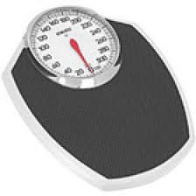
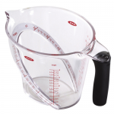
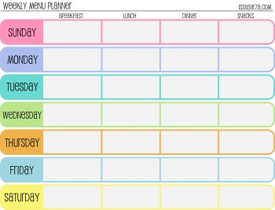
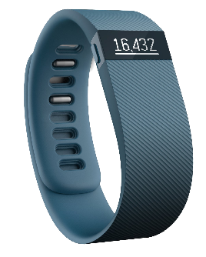
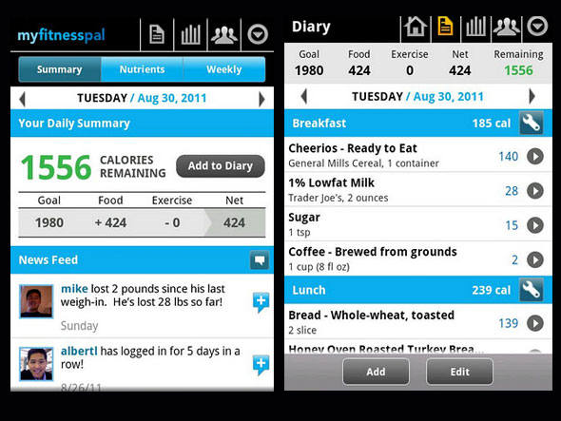
Stay on track: Use self monitoring tools
Food scale, measuring cups and spoons
Meal planning template
Food Journal
Body weight scale
Weekly weight logs
Cookbooks
Websites and blogs
Fitness Trackers (Ie: FitBit)
Apps
www.myfitnesspal.com
www.loseit.com
Baritastic
Notes:
These are the TIPS which will help U to stay on track!

Slide 15
Stay on track: Avoid mindless and emotional eating habits
Try some of these distraction strategies to manage mindless and emotional eating:
Challenge your mind to shift your thinking
Visualize your dream vacation destination
Think of a vegetable for every letter of the alphabet
Count to 10 in a language you don't know very well
Move your location to get away from food
Water your plants or garden
Go to the bathroom to rinse your face with warm water and brush your teeth
Go for a walk around the block
Walk to another level of your home or workplace
Watch TV in another room
Shift gears to an activity
Figure out five words in a crossword puzzle
Cut and arrange some flowers from your garden
Read one chapter of a book
Put on some music and dance
Phone or email a friend
Notes:
Use a distraction strategy

Slide 16
Stay on track: Practice self-care
Get adequate sleep
Sleep in dark, cool room
Avoid caffeine
Establish consistent sleep schedule
Manage your stress levels
Identify stressors in your life
Find “me” time
Practice relaxation techniques (yoga, deep breathing, meditation)
Engage in regular physical activity
Seek support
Speak to your family doctor if depressed
Find local or online bariatric surgery support groups

Slide 17
Weight Regain
Definition: >25% total body weight regain from lowest post op weight
Possible contributing factors for weight regain:
Surgical / pouch issues – uncommon but possible
Dietary / lifestyle factors
Metabolic / hormonal factors
Psychological factors (ie. Unmanaged mental health)
Medications that can increase appetite
Many patients will require a combination of therapies to manage weight (ie surgery, medication, exercise)
Intervention is recommended when weight regain is having a negative impact on a person’s health and quality of life

Slide 18
Lifestyle factors that may contribute to weight regain:
Unhealthy eating patterns, ie grazing, nibbling, skipping meals, mindless eating
Eating beyond the point of fullness
Not eating enough protein or fibre at meals (balanced meals)
Improvement or loss in dumping syndrome symptoms
Choosing high calorie food and beverages
Increased portion sizes
Eating and drinking at the same time
Emotional eating
Lack of self monitoring and self monitoring tools (journaling, weighing and measuring food)
Lack of sleep and chronic stress
Lack of physical activity
Medications

Slide 19
Recommendations for significant weight regain
1. Pharmacotherapy
Ozempic
Contrave
Saxenda
Speak your family doctor about your options for medication
Pro: Can assist with appetite reduction, non invasive
Con: Medications can be expensive, side effects, required long term
2. Revision surgery
Gastric Bypass OR Sleeve gastrectomy to Classic Duodenal Switch (DS)
DS results in more malabsorption than Bypass
Requires significant commitment to vitamin and mineral supplements
High risk surgery
Contact your bariatric surgeon to discuss your options and candidacy

Slide 20
Concerns after bariatric surgery
Nutrient deficiencies
Ulcers, bowel obstructions, hernias, gallstones
Constipation
Dumping syndrome
Hypoglycemia (low blood sugars)
Alcoholism
Excess skin
Body image issues

Slide 21
Nutrient deficiencies
Lifelong risk for deficiencies due to malabsorption of nutrients
Most common deficiencies: iron, ferritin, B12, Vitamin D, Vitamin A, Vitamin C and zinc
Take your supplements consistently as recommended
Follow-up with your family doctor once a year for blood work
See page 83 in HRH Bariatric Surgery Program resource book for list of labs you should have done annually
Symptoms of deficiencies may include fatigue, paleness, vision problems, bone loss

Slide 22
Ulcers Bowel obstructions Hernias Gallstones/ Kidney Stones
These complications can arise several years after surgery
Symptoms may include severe abdominal pain, nausea or vomiting, burning sensation in stomach, eating less than usual, a change in appetite or tolerance to food
Risk of ulcers are increased with smoking and NSAID use. Gastric bypass patients must avoid NSAID’s for life.
Contact your surgeon or go directly to ER if you are having any of the above symptoms

Slide 23
Food Intolerances
Food intolerances may persist beyond the first year and sometimes can be lifelong
Remember to eat slowly, chew food well, separate liquids and solids and prepare foods with moist cooking methods
Try braising, boiling, steaming, poaching or simmering food for optimal food tolerance
Common problematic foods:
Bread, rice, pasta, eggs, dry cooked meat/ pork/chicken, raw vegetables, lactose containing foods
Other helpful tips:
Use a slow cooker, crock pot or instant pot
Cook with tomato juice, stock, broth or low-fat cream soups
Try stew or chilis
Use sauces such as mild salsa or low- fat gravy
Avoid grilled meat
Be mindful of hidden fat and sugar
Note: If food tolerance does not improve or worsens despite following recommendations, contact your surgeon or family doctor.
Notes:
Intolerances – related to smaller stomach to break down food, less stomach acid. Certain foods are hard to break down (ie. Meat)
Also some foods stick in pouch and can get stuck in connection between pouch and small intestine

Slide 24
Dehydration
Not drinking enough fluids can increase your risk for dehydration
Symptoms may include thirst, dry mouth, headache, dizziness
To prevent dehydration:
Aim for at least 6 to 8 cups (1500 to 2000 milliliters) of noncarbonated, non caffeinated fluid per day
Drink more if you are very active, sweat excessively or are experiencing vomiting or diarrhea
Always carry a water bottle with you and remember to sip throughout the day
Notes:
Fluids – milk, water,

Slide 25
Constipation
If you experience occasional or regular constipation:
Add inulin-based fiber to liquids or foods (Fiberrific®)
Make sure you are drinking 6-8 cups (1500mL to 2000mL) of fluid daily
Increase your physical activity level
Include high fiber foods in your diet
If you have not had a bowel movement for 3 days, take Senokot S® (1 or 2 times per day)
If no bowel movement on day 4, take Milk of Magnesia ® or Restoralax ® as directed on the container
Contact your family doctor if symptoms persist

Slide 26
Dumping Syndrome
Symptoms | Blurred vision, weakness, diarrhea, abdominal pain, nausea or vomiting, heart palpitations, flushing, reactive hypoglycemia
When does it happen? | 20-30 minutes after eating a meal or snack containing high sugar or high fat foods Some individuals experience dumping syndrome 2 hours after eating high sugar or high fat foods. This is called late dumping syndrome (or reactive hypoglycemia). Late dumping causes low blood sugars.
Why does it happen? | Physiological reaction because of changes in digestion after bypass Undigested concentrated food in jejunum
Management | Avoid high sugar and high fat foods Ice cream, cake, chocolate, cookies, pastries, chips, pretzels, crackers, fried food, sweetened beverages, Read food labels Sugar <10g per serving Fat 3g or less OR less than 5% D.V.
https://youtu.be/6iinFDB4g1M https://youtu.be/tAPb7GRfIJE

Slide 27
Hypoglycemia (Low blood sugar)
Low blood sugars can happen after bariatric surgery even if you were not diabetic before surgery!
If you do not get it treated right away, low blood sugar can cause a medical emergency.
A low blood sugar is 4.0mmol/L or less
What are symptoms of low blood sugar?
Shaky or dizzy
Sweaty
Weak or tired
Hungry
Headache
Upset/nervous

Slide 28
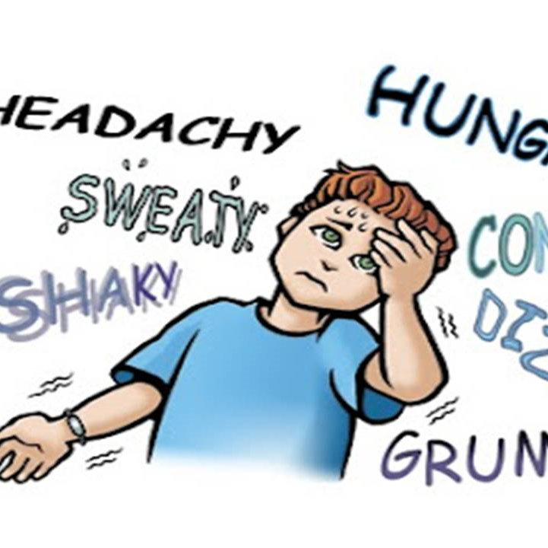
Hypoglycemia (Low blood sugar)
What causes a low blood sugar?
Skipping meals, long gap between meals, poor meal balance
Avoiding carbohydrates completely
Eating less than you should
Doing more physical activity than usual without eating
Drinking alcohol
Taking too much diabetes medication
Late dumping syndrome (reactive hypoglycemia); 2 hours after eating high sugar / high fat foods OR eating too fast / drinking with meals
Treat with DEX4 tablets OR glucose tablets (see pg 93 in HRH Bariatric Surgery Program resource book)
Speak with your family doctor if you have signs or symptoms of low blood sugars

Slide 29
Hypoglycemia vs. Reactive Hypoglycemia
 | Hypoglycemia | Reactive Hypoglycemia (late dumping syndrome)
Symptoms | Blood glucose <4.0mmol/L Dizziness Shakiness Irritability | Blood glucose <4.0mmol/L Dizziness Shakiness Irritability Palpitations Weakness Perspiration Hunger Confusion
When does it happen? | Any time after bypass Can happen any time of day | May start 1-2 years after bypass Usually 1-3 hours after eating a meal or snack
Why does it happen? | Missed meals Not eating enough at meals Too much diabetes medications | Dietary habits / food choices Too much insulin / GLP-1
Management | 6-8 small, frequent meals (eat every 2-3 hours) Avoid simple/ refined carbohydrates Meals should be well balanced Protein + fibre at snacks Avoid drinking with meals and for ~30 min after solid food Avoid alcohol, sweetened beverages | 6-8 small, frequent meals (eat every 2-3 hours) Avoid simple/ refined carbohydrates Meals should not exceed 30 grams of Carbohydrate Protein + fibre at all meals and snacks Avoid drinking with meals and for ~30 min after solid food Avoid alcohol, sweetened beverages May need medication if no improvement after dietary changes (Acarbose)

Slide 30
Effects of alcohol intake after Bariatric Surgery
Patients with a history of addiction are at increased risk for developing alcohol dependence
Seek help of your family doctor, social worker, psychologist or psychiatrist if you are concerned about your alcohol intake
Drinking alcohol can cause the following:
weight gain or poor weight loss
possibility of low blood sugars
delayed wound healing
risk of ulcers or cirrhosis
increased risk of blackouts

Slide 31
Alcohol and driving after Bariatric Surgery
Alcohol may be absorbed more quickly into the body after bariatric surgery.
Blood Alcohol Concentration (BAC) peaks higher and faster and takes longer to return to normal due to altered metabolism after bariatric surgery
Remember that after surgery, even small amounts of alcohol can cause intoxication and low blood sugar.
Do not drink and drive or operate any heavy machinery after consuming even minimal amounts of alcohol

Slide 32
Excess skin / Body contouring
You may start discussing plans for removal of excess skin with the Surgeon at 1.5 years after bariatric surgery if excess skin is a concern
Not recommended to have skin removal surgery before 2 years after bariatric surgery
Excess skin removal/ body conturing after bariatric surgery is typically not covered by OHIP
Some patient’s find excess skin distressing, or some have issues with skin integrity and sores

Slide 33
Pregnancy Recommendations
Rapid weight loss increases fertility
It is recommended that pregnancy be avoided until 18 months after bariatric surgery for the following reasons:
To prevent nutritional deficiencies
To prevent any complications during pregnancy
To be able to support a healthy fetus
Use two non-pill form of contraceptives after bariatric surgery
Recommended pregnancy weight gain is same as non bariatric patient’s and based on your BMI
Follow same guidelines discussed today in terms of meal routine, balanced meals, protein intake & fluids
Discuss your options with your family doctor

Slide 34
Next steps
Remember that falling off track with bariatric recommendations can happen over time
You can always get back on track with your goals, no matter how far out you are from your surgery
Start by following the recommendations in this presentation
Regular follow up with your family doctor can help you stay on top of your health needs
Ask for support if you need it
Get your labs done yearly!
Final thoughts…

Slide 35
Final Thoughts
Long term Success after Bariatric Surgery
Healthy Diet
Regular Exercise
Mindful Eating
Commitment
Yearly follow up with family MD
Regular Supplements

